Slide 1

Computer Forensics 2
What’s on your hard drive?
Dr Diane Gan

Slide 2
Computer Forensics 2
Lecturers
Diane Gan
Tuan Vuong
Course structure
2 hr lecture
1 hr lab

Slide 3
Course
50% coursework
50% exam
Specialist software
EnCase
FTK
FTK Imager
FTK Registry Viewer
PRTK – password recovery tool kit
Hex editors
+ more

Slide 4
Coursework
Given a evidence files
You will have information about the case
Investigate the case, using any tools
Write a report using a given template
Present the evidence in court as an expert witness

Slide 5
Topics
Common crimes, Report writing
The Law, CMA, RIPA, PCJA
Collecting/presenting legal evidence
Introduction to Tools (EnCase, FTK, hexeditor, +)
Chain of evidence, creating read only images
Hiding information
Windows artefacts
Deleted files
Graphic formats – compression – headers - content
File Systems, disks and hard drives, other media
Operating Systems and volatile memory
Introduction to Mobile Phones

Slide 6
Introduction
Where is the Evidence
What is the Evidence
Computer Forensic Tools
Documenting the Investigation
Handling the Crime Scene
Ears, Eyes, Hands
Computer Evidence
Digital Evidence

Slide 7
Crime Scene investigation
Searching and Collecting evidence
Do’s and Don’ts
Software used:
EnCase
FTK
Open source products (i.e. Free tools)
Virtual PC
Notes:
Free software can be found here:-
http://www.forensic-computing.ltd.uk/tools.htm#forensic_windows

Slide 8
Overview - today
What is computer forensics?
Crime Scene
Types of evidence
Performing a Disk-based Investigation
Tools
What are we looking for?
Conclusion
Notes:
A very nice article called “Computer Forensics Explained”
http://www.exploreforensics.co.uk/computer-forensics-explained.html

Slide 9
What is Computer Forensics?
Computer Science is a relatively new discipline
“Computer forensic science is the science of acquiring, retrieving, preserving, and presenting data that has been processed electronically and stored on computer media” [1]
“Computer Forensics is the collection, preservation, analysis and court presentation of computer-related evidence.” [2]
Why do we need Computer Forensics?
Documents in electronic format
Recovery of deleted files
Ensures the preservation and authentication of computer data
Notes:
Why do we need Computer Forensics?
The vast majority of documents in electronic format. No investigation is complete without reviewing documents relating to a crime. This takes the form of properly handled computer evidence.
Recovery of deleted files is very important as documents vital to the investigation could be recovered.
Ensures the preservation and authentication of computer data because computer evidence is fragile and easily damaged, erased or altered. There is also the issue of proving that the evidence has not been tampered with during the investigation.
References
1. Robert C. Newman, Computer Forensics: Evidence Collection and Management, Page 5
2. John R. Vacca, Computer Forensics – Computer Crime Scene Investigation, p4, pub Charles Riva Media ISBN 1-58450-389-0

Slide 10
What is the crime?
Who might you be working for?
What is the evidence?

Slide 11
What is the crime?
Theft of trade secrets
Fraud
Extortion
Industrial espionage
Pornography
Pedophile rings
Obscene publications
Sexual harassment
Unauthorized use of personal information
Forgery
Identify Theft
Defamation
Credit card cloning
Shop-lifting (CTV footage)
Theft of or destruction of intellectual property
Unauthorized activity (hacking)
Counterfeiting
Software Piracy
Embezzlement
SPAM investigations
Virus/Trojan distribution
Immigration fraud
Narcotics trafficking
Bank robbery
Homicide investigations
Contract killings
Traffic accident – CTV footage
Vandalism

Slide 12
Who might you be working for?
Criminal Prosecutors
Rely on evidence obtained from a computer to prosecute suspects and use as evidence
Civil Litigations
Personal and business data discovered on a computer can be used in fraud, divorce, harassment, or discrimination cases
Insurance Companies
Evidence discovered on computer can be used to mollify costs (fraud, worker’s compensation, arson, etc)
Private Corporations
Obtained evidence from employee computers can be used as evidence in harassment, fraud, and embezzlement cases
Law Enforcement Officials
Rely on computer forensics to backup search warrants and post-seizure handling
Individual/Private Citizens
Obtain the services of professional computer forensic specialists to support claims of harassment, abuse, or wrongful termination from employment

Slide 13
What is the evidence?
Volatile Information
Network Information
Network connections open - ports
Active Processes
Programs and daemons currently active on the system
Logged-on Users
Users/employees currently using system
Open Files
Libraries in use; hidden files; Trojans (rootkit) loaded in system

Slide 14
Volatile Data
Registers and cache
Routing tables, ARP cache, process tables and kernel statistics
Contents of system memory
Temporary file systems
Data on disk
Tools?
Notes:
Collecting volatile information presents a problem because this can change the state of the system, and even the contents of the memory itself.
Tools to do this are:-
Netstat
Nbtstat
Arp
tasklist
Ipconfig
etc

Slide 15
Non-Volatile Information
includes
file information, configuration settings, system files
registry settings
logs from monitoring devices
logs from hosts and servers
accessed through use of tools
should be investigated ONLY from a backup copy (read only)

Slide 16
The Crime Scene
A crime has been committed
What happens next?
Collect evidence in a forensically sound manner
“Evidence is the proof of a fact about what did or did not happen”
“What is needed to ‘prove a fact’ about a crime when there are no eye witnesses?”
“All evidence must be reliable and relevant to the case to be legally admissible”
Notes:
The first known digital forensics investigator was Clifford Stoll. He managed the computers at the Lawrence Berkeley National Laboratory in California. In 1986 he was asked by his supervisor to look into an accounting error of 0.75$. His investigation led him to identify that 9 seconds of network time had not been paid for. He concluded that this was the work of a hacker. He then spent 10 months tracking this hacker down. By identifying that he was using a modem and a dialup line, he managed to track the hacker to Germany. He setup a honeypot to lure the hacker and record his activities. The hacker turned out to be selling secrets to the KGB and was subsequently arrested.
Stoll later went on to write the famous book “The Cuckoo’s Egg” in which he told the story of how he caught Markus Hess.
Ref: http://en.wikipedia.org/wiki/The_Cuckoo%27s_Egg

Slide 17
Three main types of evidence:-
Testimony of a witness
Physical evidence – autopsy of a body, bullet, knife wound, footprint, fingerprint, DNA, etc.
Electronic evidence – IP address, computer virus, email, voice mail, cookie, log file, etc
E-evidence - gathered using a computer or IT autopsy
Activity on the computer leaves a digital footprint

Slide 18
Problem
evidence on a hard drive is considered to be hearsay
computer generated files are not
business records (with time stamps etc).
computer stored files are hearsay
unless they fall under the business records rule
Exception – Business records
historical records that can be verified
Examples - email (if archived), memos, reports, log files

Slide 19
What is the problem?
Maintaining the Chain of Custody
Digital evidence
exists in digital form ( 1‘s and 0’s)
is easily damaged
can be modified (bits changed)
digital copies and original evidence are indistinguishable
integrity of evidence can be questioned

Slide 20
Locard’s Exchange Principle
Interacting with the system changes things
e.g. two computers connected via a network
But changes can occur as time passes and the system just runs
Running a program on a system may change physical memory
Physical memory may then be written out to disk to make room (page file)
Changes that occur on a system as the system sits idle are called “evidence dynamics”
Like rain washing away evidence at a crime scene
Notes:
Locard’s Exchange Principle
“In the early 20th century, Dr Edmond Locard’s work in the area of forensics science are crime scene reconstruction became known as Locards’s Exchange Principle. When two objects come into contact, material is exchanged between them. For example, when a car hits something, or when an investigator examines a body and finds material that seems out of place.”
Ref: Windows Forensics Analysis – DVD Toolkit 2E by Harlan Carvey – pub Syngress – ISBN:978-1-59479-422-9

Slide 21
Some information has a longer shelf life than others
Example – unused network connections time out in minutes
Check this yourself using netstat
Contents of clipboard
Services and daemons (Unix)
Information on this is found in RFC3227
Specifies principles for evidence collection to capture an accurate picture of the system
Notes:
www.faqs.org/rfcs/rfc3227.html

Slide 22
When considering whether to proceed with a live response consider:-
Although your actions have an effect on the system under investigation, so does your doing nothing
Processes are running
Actions are occurring
Programmes used to collect evidence have effects
Investigator runs a program that has already run previously – what is the effect?
Last access and modified times are changed
Contents of a file can be changed/registry values can be changed
Investigator runs a program that has never run before – what is the effect?
A new prefetch file is created in the Prefetch directory
Understand the changes and document them
Notes:
Example
On an XP system – wait 24 hours and a System Restore Point is created automatically. Wait 3 days and the system will perform a limited defrag of the hard drive. If someone is stealing information from the systems, then doing nothing will enable them to continue.

Slide 23
Incident has already occurred
Acquisition
Incident is ongoing – needs different tool set
Chain of custody
Physical – hardware or software components
Identification
Logical – an address or the location of evidence
Documentation of results – all steps must be repeatable
Evaluation
Relevance to the case
Could result in the case being thrown out of court
Chain of custody must be complete
Presentation
Discard evidence which will confuse a jury
Expert witness must be able to defend their findings

Slide 24
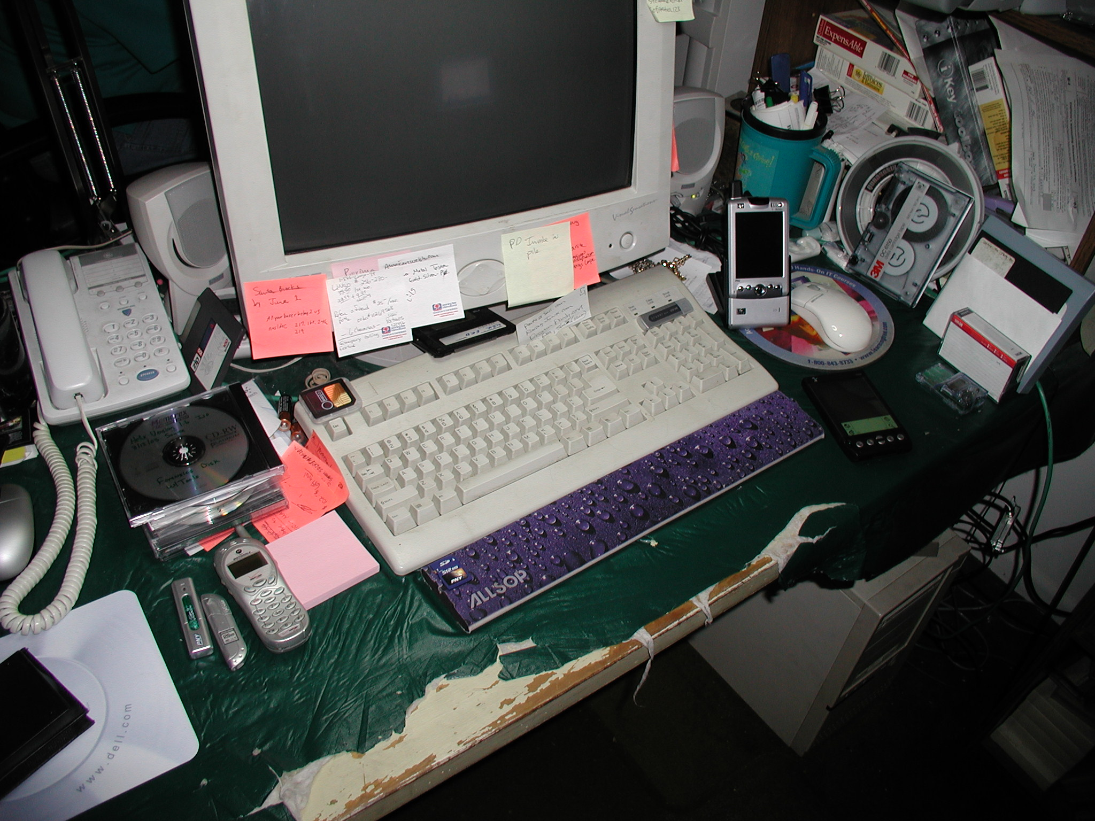

Slide 25
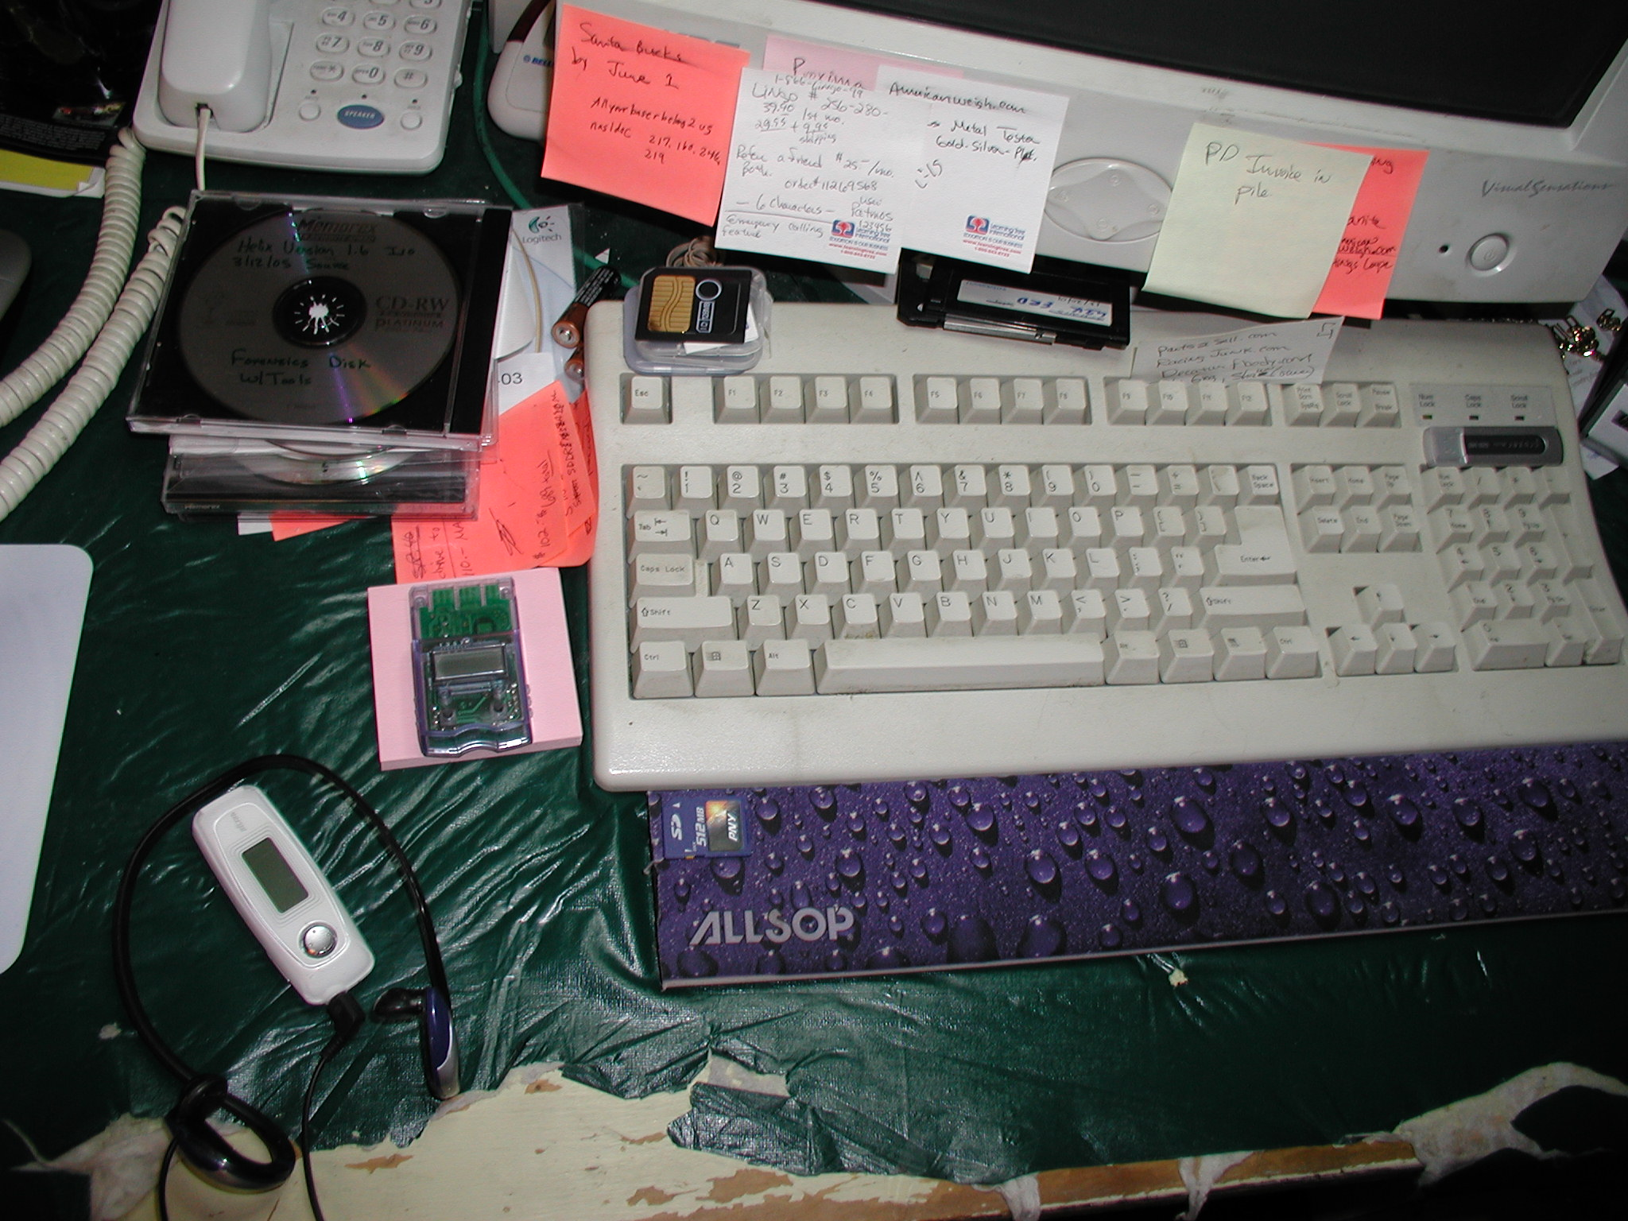

Slide 26
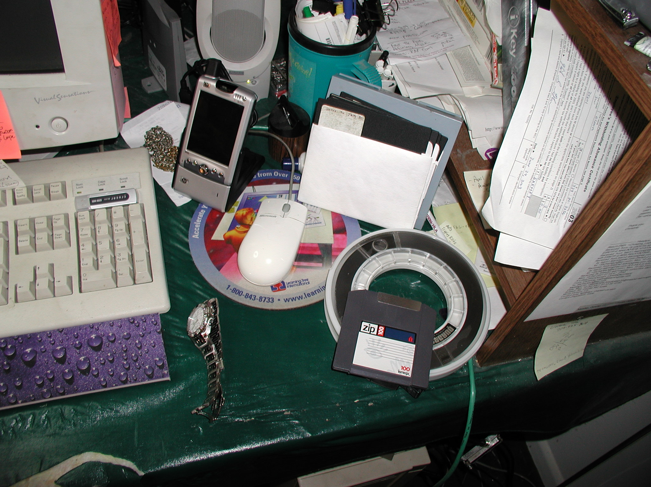

Slide 27
Computer generated records
must be shown to be from a particular machine
may not be modified in any way
identify the user or service account
Corroborate the evidence using
emails with similar words, phrases, or passwords
file creation, modification access, times that match when a user was logged on
Potential loss of evidence
rebooting (volatile information)
shut down – everything in RAM is lost
NEVER USE SHUT DOWN

Slide 28
Performing a Disk-Based Investigation
Create an identical copy of the suspect’s drive
Read ONLY
Hashing - one way function
message digest
can not be undone
used for integrity checking – MD5 or SHA1
always produces the same result
IF nothing has changed!
Would rebooting a machine be a problem?

Slide 29
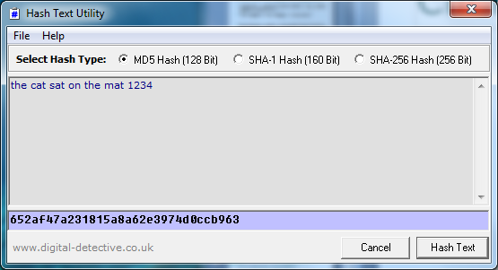
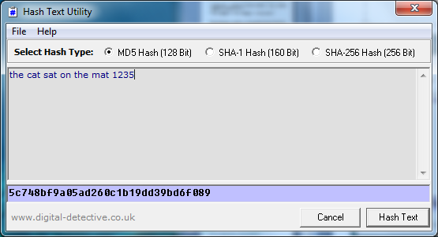
652af47a231815a8a62e3974d0ccb963
5c748bf9a05ad260c1b19dd39bd6f089
Importance of the hash

Slide 30
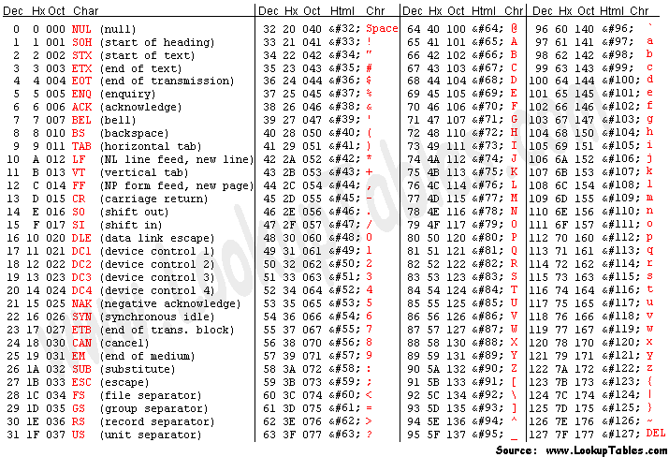

Slide 31
4 = ASCII 34₁₆ 00110100
5 = ASCII 35₁₆ 00110101
0 0 1 1 0 1 0 0
0 0 1 1 0 1 0 1
MD5
652af47a231815a8a62e3974d0ccb963
5c748bf9a05ad260c1b19dd39bd6f089

Slide 32
Evidence collection
safely shut down computer
reboot with floppy/CD/USB
secure the computer - create the backup
EnCase bit stream or mirror disk
read only copy
cryptographically sign evidence
encrypt evidence (optional)
put into chain of custody

Slide 33
Assuming we have a read-only copy of the hard drive:-
Tools for analysis FTK
Encase
Sleuth kit
Autopsy
Hex editor
use multiple tools for validation
boot a suspect machine using a CD-ROM or USB that contains a commercial forensic tool

Slide 34
Example
data is stored in a 4KB block (cluster)
called an allocation unit
smallest unit that can be allocated to a file
Free Space
Data
Data
Data
free
Data
4 KB block
3200 bytes of used space in this cluster
800 bytes of slack space
A typical 4 KB cluster in use
Slack Space

Slide 35
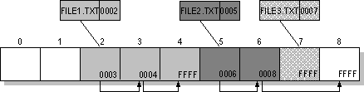
File storage
What happens if a file is deleted?

Slide 36
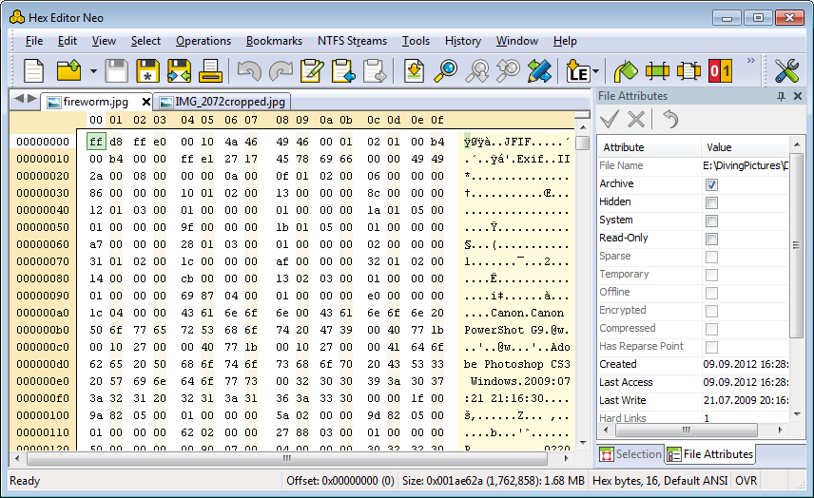
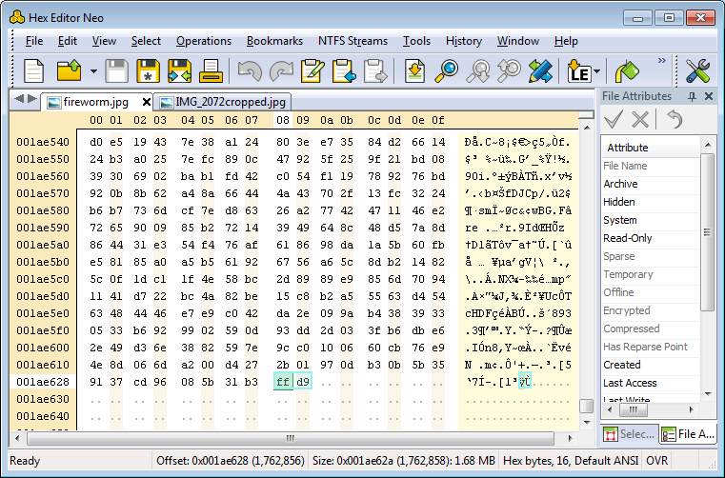

Slide 37
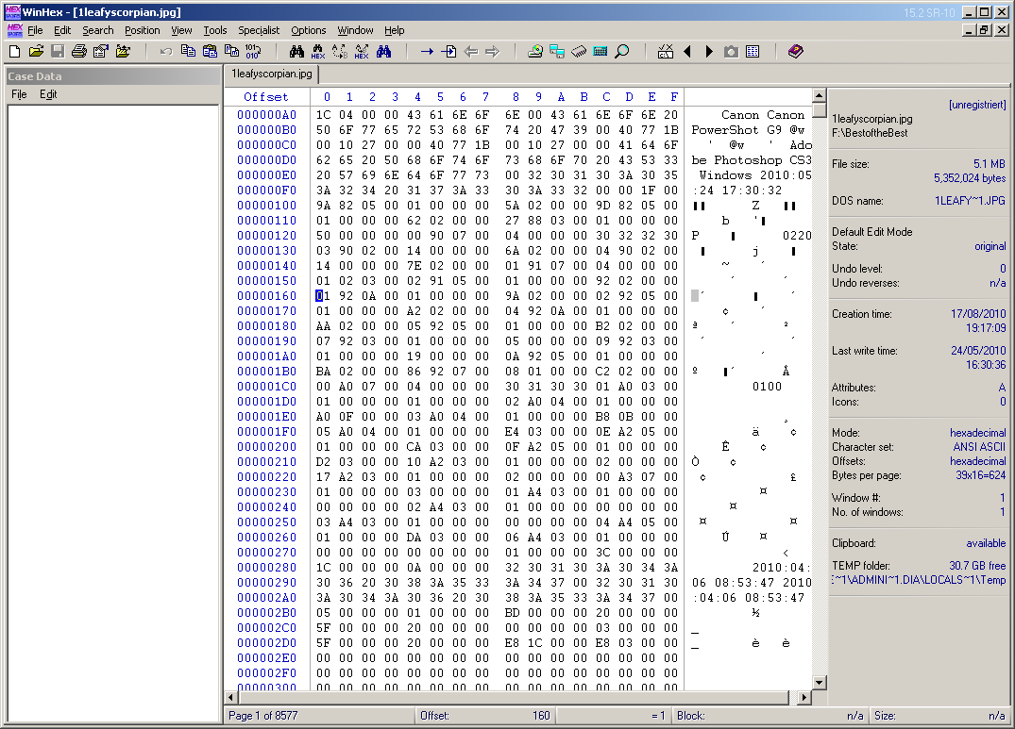

Slide 38
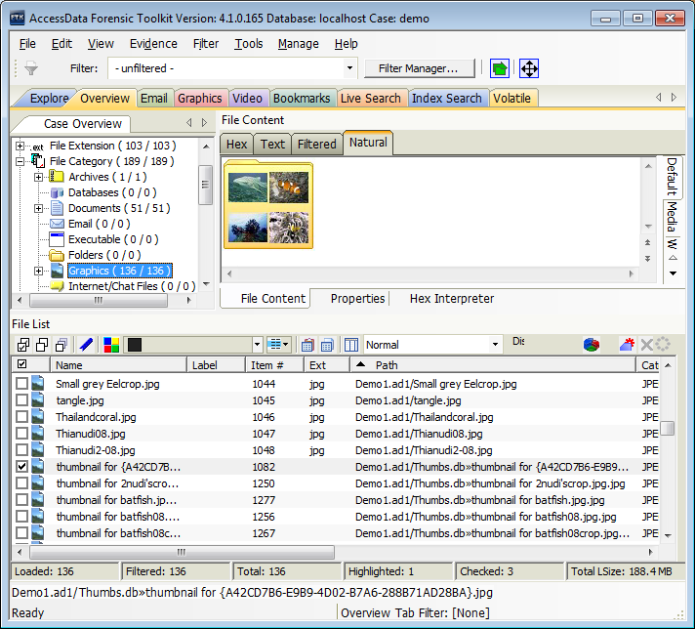
FTK

Slide 39
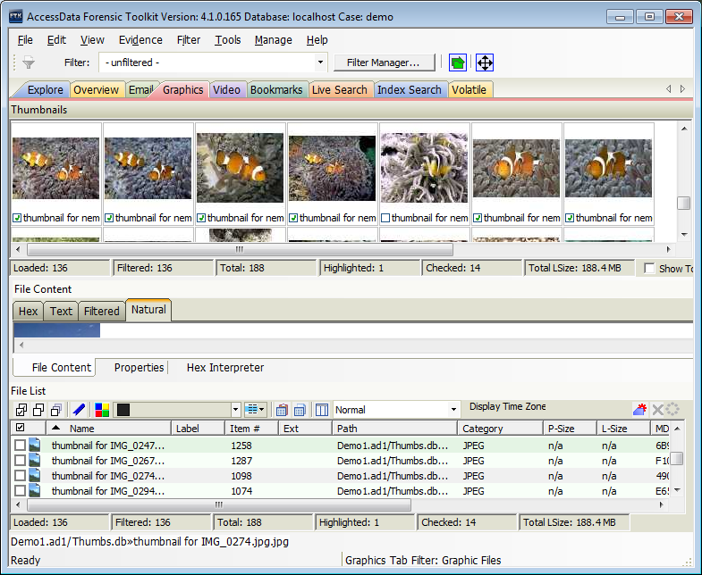

Slide 40
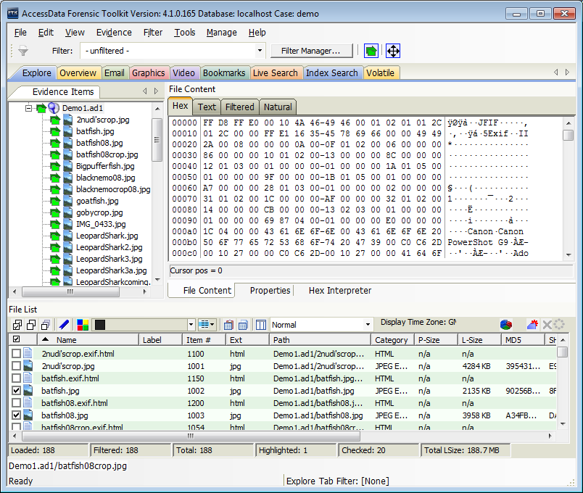

Slide 41
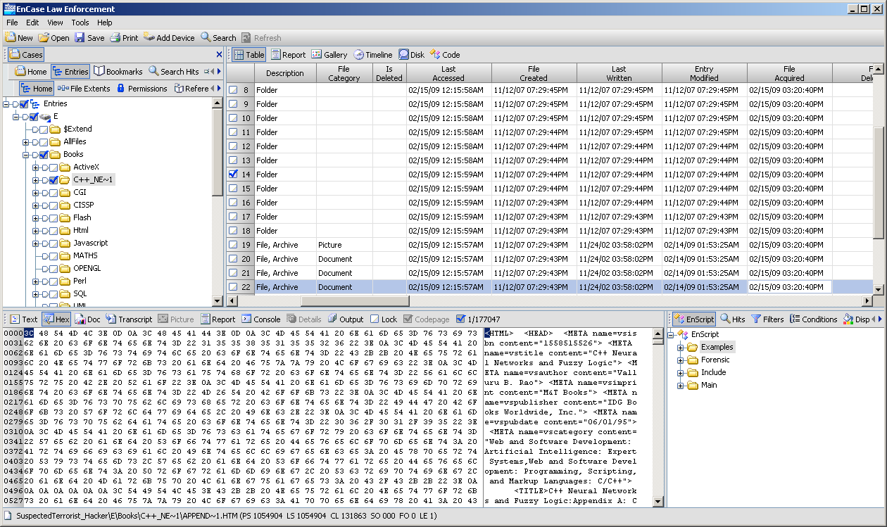
EnCase

Slide 42
What are we looking for?
Hidden files
use Hfind (tool to locate hidden files)
hidden file attributes
steganography
slack space
unallocated clusters
file mangling
recycle bin
deleted files

Slide 43
Alternate Data Streams (ADS)
NTFS - provide advanced functionality (metadata)
storage of distributed link tracking Object Identifiers (OIDs)
indexable content summaries for files
thumbnail images
Compatibility with Mac Hierarchical File System (HFS)
Holds
information on author, etc.
security information – e.g. access permissions
However, they can store anything – such as executable applications, encrypted data, music MP3, copyrighted, classified, sensitive information, Trojan code, .bmp .jpg. .gif

Slide 44
Myfile.ext
Visible to all file systems
Main unnamed stream
Myfile.ext:Stream 1
Stream 1
Myfile.ext:Stream 2
Stream 2
Visible to NTFS volumes only
Myfile.ext:Stream n
Stream n
Does this show up when the file is listed?
Can you see the size of the stream?
Notes:
Ref: Dissecting NTFS Hidden Streams by Chetan Gupta, NII Consulting
www.niiconsulting.com

Slide 45
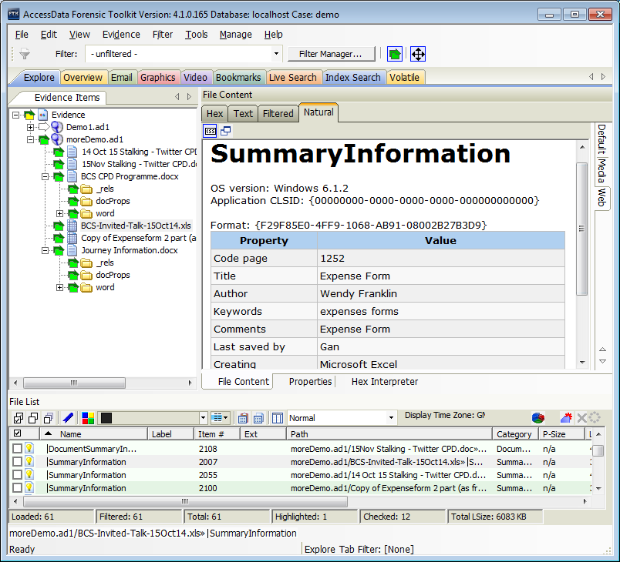

Slide 46
ADSs can be attached to folders and drives
Have no attributes of their own
Malicious files may not be detected by anti-spyware
MS Windows provides no utilities to detect ADS
Streams have been used to remotely exploit web servers using
http://www.abc.com/index.asp:$DATA
Good news
Cannot accidentally execute a stream
Internet protocols that transfer files don’t support streams

Slide 47
How to create an ADS?
Use
redirection ( > ) and :
GUI utilities e.g. Streams.exe
Windows Management Instrumentation Methods from a VBScript
Data can be compressed or encrypted prior to being written to the stream
Add password
Searching for ADS
Streams.exe
LADS.exe
CrucialADS.exe
Notes:
Streams.exe from www.sysinternals.com
LADS.exe from www.heysoft.de.nt/ep-lads.htm
CrucialADS.exe from www.crucialsecurity.com

Slide 48
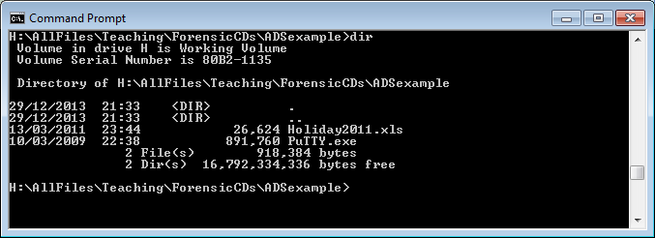
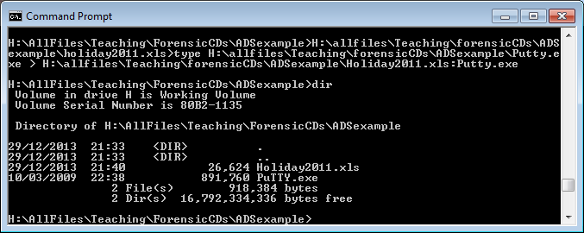
BEFORE
Has anything changed?
AFTER writing ADS

Slide 49
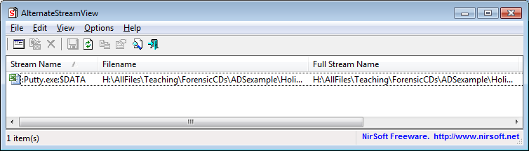
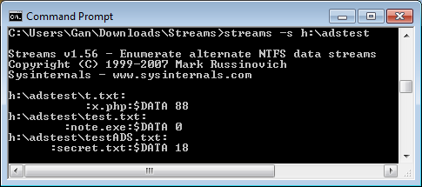
Detecting an ADS
This could have been Netcat.exe
Renamed as a common file
Set it running to listen on a port

Slide 50
Steganography
The art of concealing information in plain sight
Two methods
insertion – one file is inserted into another
substitution – replaces bits of a carrier with bits from the covert file
the carrier program must behave normally
Good candidates bitmaps, GIFs and MPEGs

Slide 51
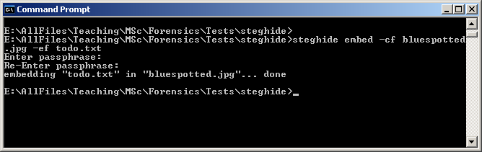
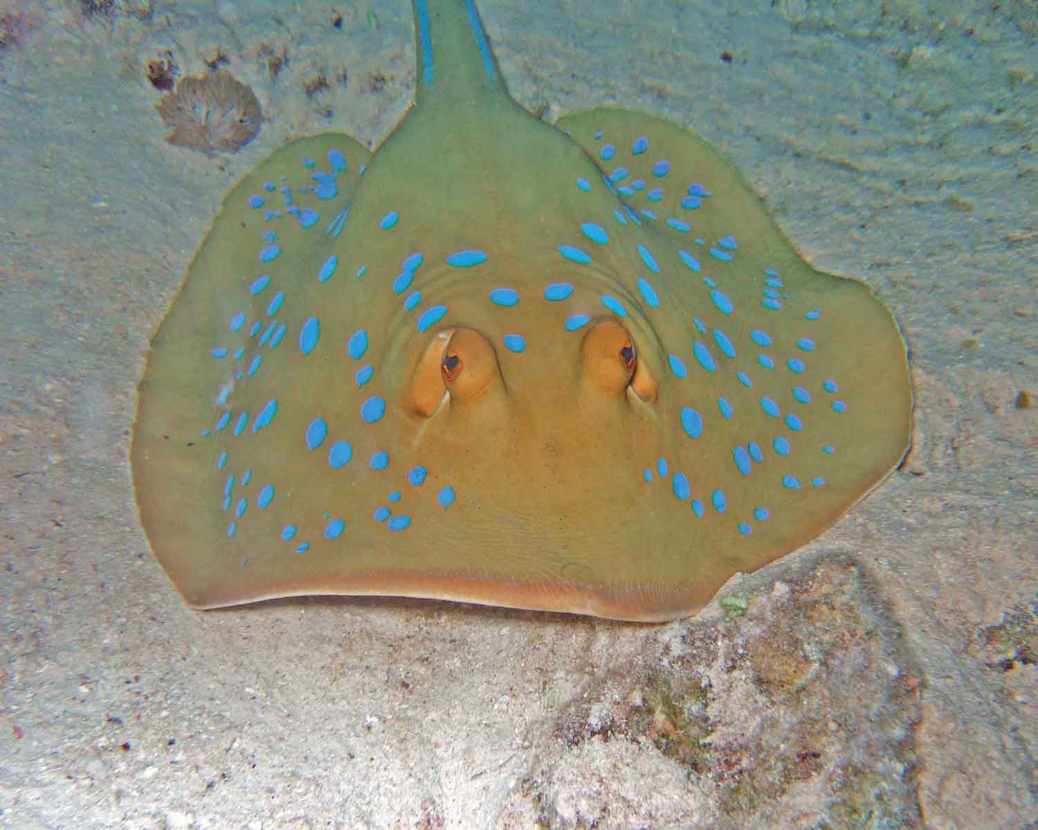
Before – 103KB
After – 101 KB

Slide 52
File Mangling
changing the file extension from
.doc to .xls or from .gif to .jpg or from .mp3 to .wav
inspect the file headers for signatures
File types .sys
.dll
.drv
.exe
MZ signature in the file header
Forensic tools, e.g. EnCase has this facility

Slide 53
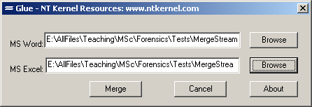
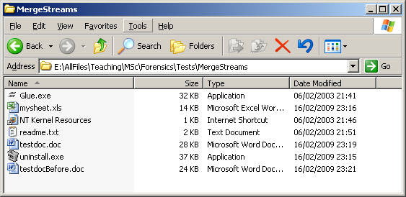

Slide 54
Conclusion
Collecting evidence is not easy
Presenting evidence for a court is even harder
Very important to maintain the chain of custody
Bottom line – very hard to get convictions
Many companies just plug the hole

Slide 55
Lab
Things are not always as they appear
Capturing Volatile Information
Other Tools – run on a command line
Creating Alternative Data Streams

